Slide 1
Physics Engine (Typhoon)
Particle Engine
Mass Aggregate Engine
Rigid bodies Engine

Slide 2
Physics Engine (Typhoon)
Typhoon
Core
Rigid Body Engine
Particle System Engine
Mass Aggregate Engine
Vector
Quaternion
Matrix3
Matrix4
Force Generators
Links
Force & Torque Generator
Contacts
Contact resolution
Contacts

Slide 3
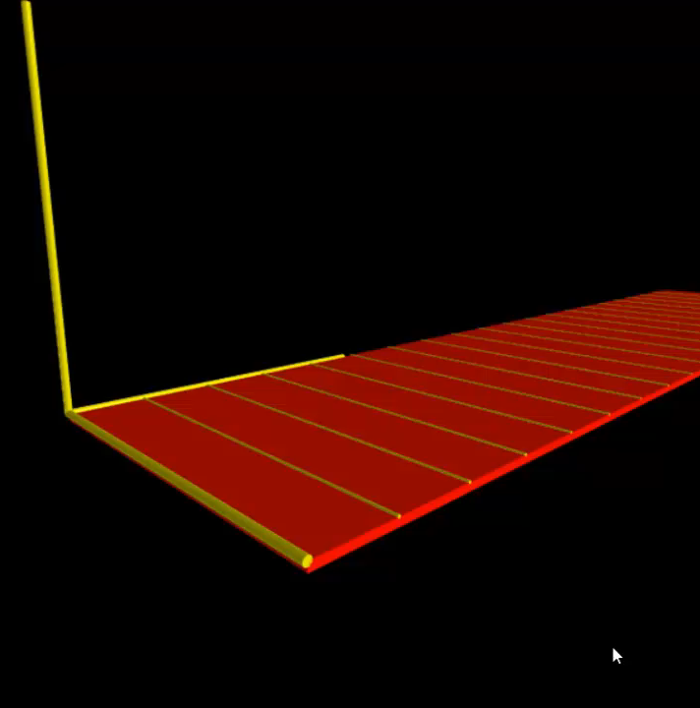
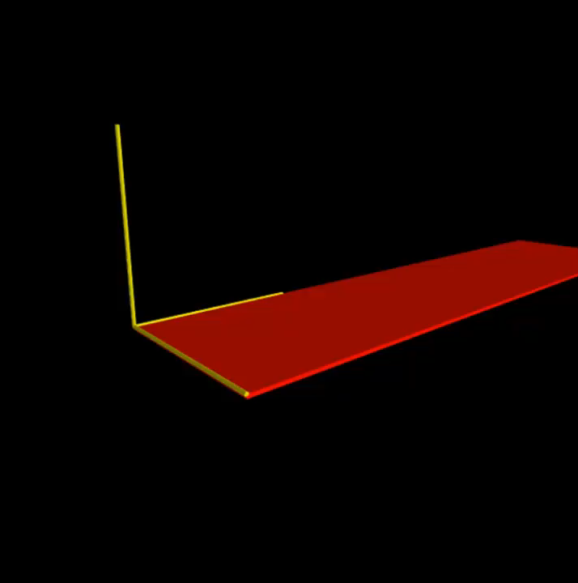
Physics Engine (Typhoon)

Slide 4
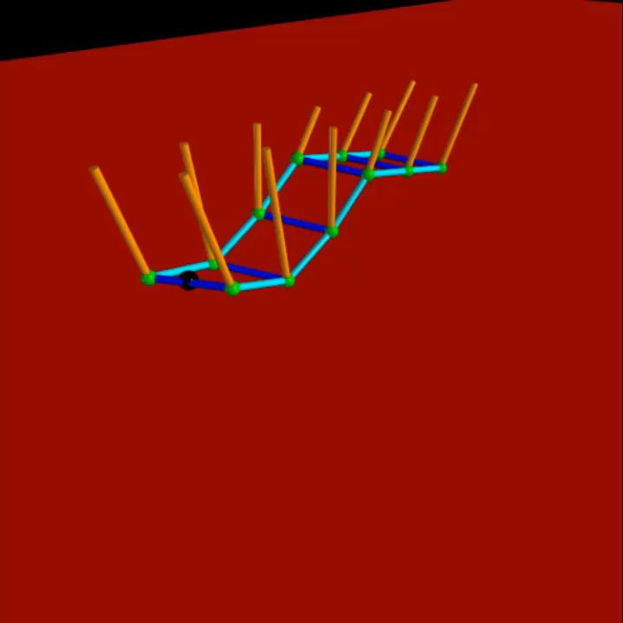
Physics Engine (Typhoon)

Slide 5
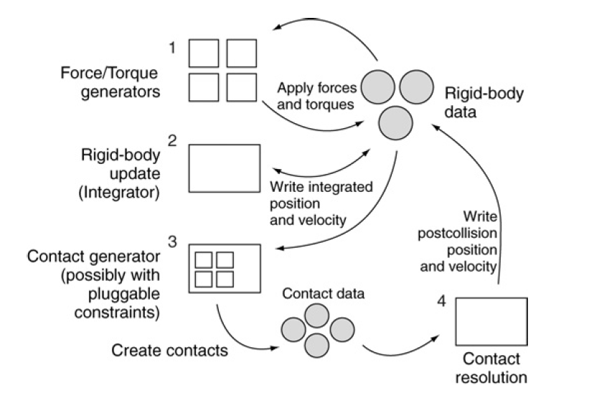
Physics Engine (Typhoon)

Slide 6
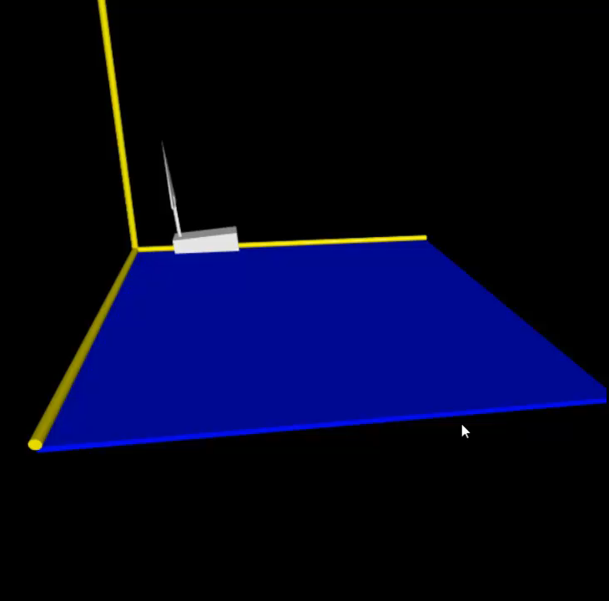
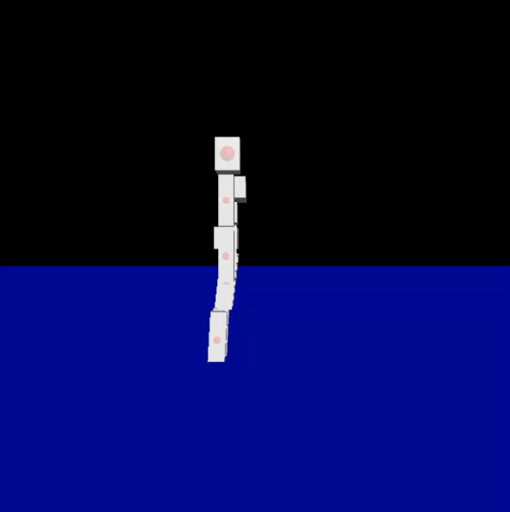
Physics Engine (Typhoon)

Slide 7
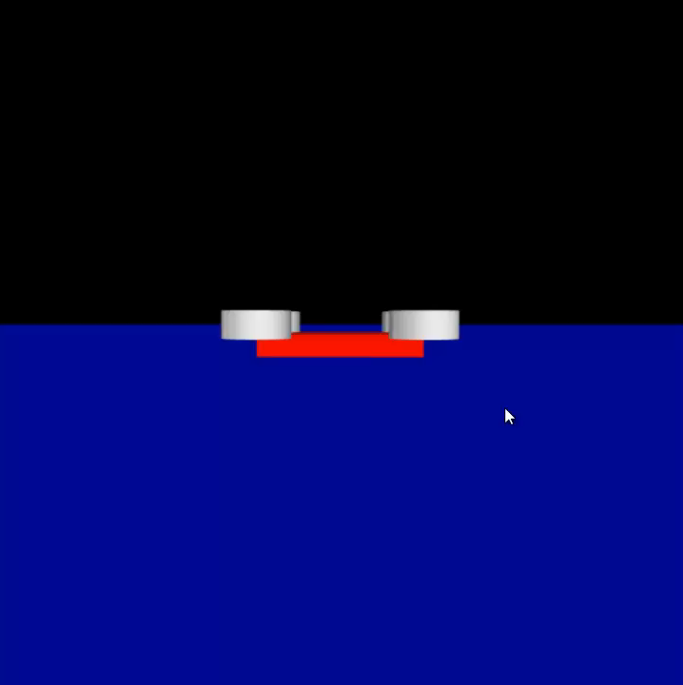
Physics Engine (Typhoon)

Slide 8
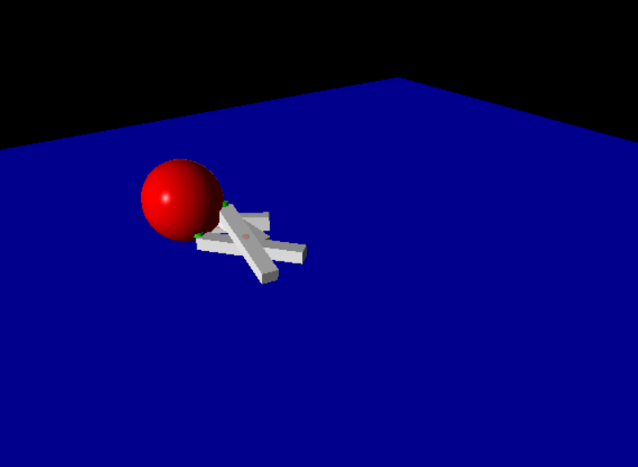
Physics Engine (Typhoon)

